Slide 1
How to Write an Awesome Five Paragraph Essay
The Easy Way!
By the Greatest Teacher Ever
Mr. McDaniel

Slide 2
Let us start with…
Four Tips
Here are some great tips on how to organize and write an easy five paragraph essay!

Slide 3
Tip #1
Don’t Stress
An assignment to write an essay may seem difficult at first, but if broken down into parts, it is much easier and can be fun.

Slide 4
Tip #2
Essay Structure
It is important to have the correct structure for your essay to help organize your thoughts and ideas which can help prevent writing off topic and wasting time. Failing to have the correct essay structure can certainly cause you confusion and will make the process seem more difficult.
That is why I suggest doing every step of the writing process (yes, there is a process) for every single essay you do. The first step is…

Slide 6
That’s right…
Brainstorm
A brainstorm is a writing technique used to getting your ideas from your head down on to paper. If you keep all of your ideas in your head, you are libel to get them confused, forget some, or give yourself a headache. Write them down as they come to you. It works…trust me!
Here is one example of a type of brainstorm called a concept map.
I call it a bubble map…

Slide 7
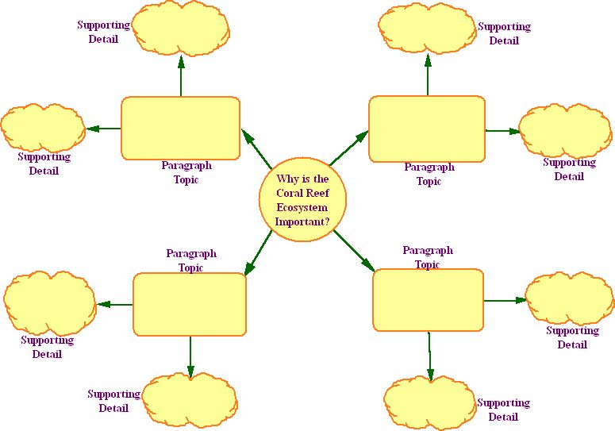

Slide 8
Next, you should do an…
Outline
An outline lets you take the ideas you came up with in your brainstorm and arrange them in a way that most essays should look like. This is how you ORGANIZE your thoughts and make it look professional. If you do the outline correctly and fill in as much information and details as you can, your essay is practically done!
Don’t know what an outline looks like?
Take a look at this…

Slide 9
Introduction
1. Hook
2. Thesis
3. Three Sub-Topics
4. Conclusion/Transition
1st Body Paragraph
1. Topic Sentence
2.Details
3. Examples
4. Conclusion/Transition
2nd Body Paragraph
1. Topic Sentence
2.Details
3. Examples
4. Conclusion/Transition
IV. 3rd Body Paragraph
1. Topic Sentence
2.Details
3. Examples
4. Conclusion/Transition
Conclusion
1. Restate Thesis
2. Restate 3 Sub-Topics
3. Remind Reader of Importance
4. End with a Bang!

Slide 10
Your first paragraph should look like this:
Introduction Paragraph
Hook (tell us something interesting that will make us want to read your essay)

Slide 11
Your first paragraph should look like this:
Introduction Paragraph
Hook (tell us something interesting that will make us want to read your essay)
Thesis (this is your main idea/topic, what the essay is all about)

Slide 12
Your first paragraph should look like this:
Introduction Paragraph
Hook (tell us something interesting that will make us want to read your essay)
Thesis (this is your main idea/topic, what the essay is all about)
Sub-Topics (name the three main things you are going to write about your topic; each one of these things will be used as the topic sentences for your body paragraphs)

Slide 13
Your first paragraph should look like this:
Introduction Paragraph
Hook (tell us something interesting that will make us want to read your essay)
Thesis (this is your main idea/topic, what the essay is all about)
Sub-Topics (name the three main things you are going to write about your topic; each one of these things will be used as the topic sentences for your body paragraphs)
Conclusion/Transition (write what we should always remember about this topic or prepare us for the next paragraph by leading us in)

Slide 14
Your first paragraph should look like this:
Introduction Paragraph
Hook (tell us something interesting that will make us want to read your essay)
Thesis (this is your main idea/topic, what the essay is all about)
Sub-Topics (name the three main things you are going to write about your topic; each one of these things will be used as the topic sentences for your body paragraphs)
Conclusion/Transition (write what we should always remember about this topic or prepare us for the next paragraph by leading us in)
Fill in each part with at least one complete sentence.
Your next three paragraphs should look like this…

Slide 15
Three Body Paragraphs
Write your topic sentence here: (this should be one of your three Sub-Topic, one for each body paragraph)

Slide 16
Three Body Paragraphs
Write your topic sentence here: (this should be one of your three Sub-Topics, one for each body paragraph)
Detail/Fact (support from your notes):
Give an Example:
Detail/Fact (support from your notes):
Give an Example:

Slide 17
Three Body Paragraphs
Write your topic sentence here: (this should be one of your three Sub-Topics, one for each body paragraph)
Detail/Fact (support from your notes):
Give an Example:
Detail/Fact (support from your notes):
Give an Example:
Conclusion/Transition (final thought or lead us into the next paragraph)
Now on to your final paragraph!

Slide 18
The Conclusion Paragraph
(get all of this information from your Introduction Paragraph)
Restate (but don’t just copy…in other words, put it in different words) your
Thesis:
Restate 3 Sub-Topics:
Remind us of importance (why should we care?):
End with bang (leave us with a final thought that tells us what was so important)
Remember, people always remember the first thing you say and the last. That is why the introduction and conclusion are so important.

Slide 19
Expository
(meaning to expose)
Explain
Clarify
Inform
Define
Instruct
Usually non-fiction
Persuasive
(to persuade)
Argue
Influence
Convince
Debate
Promote
Opinion driven
Expository vs. Persuasive

Slide 20
Another major difference between an Expository essay and a Persuasive is…
Details
Instead of a main topic for your thesis, you present your main argument or opinion
Your Sub-Topics become Supporting Arguments
The details and examples are facts and information that support your arguments (some may need to cited from references)
You don’t end with a Bang; now tell the reader what you want them to do by giving them a Call-to-Action!
Did you know there was another paragraph added too…

Slide 21
The Counterargument
This is where you give voice to any opposing opinions that may contradict your main argument. This paragraph goes in-between your Third Body Paragraph and the Conclusion Paragraph in your essay.
Opposing Argument or Opinion
Destroy
Destroy
Destroy
Conclusion/Transition
Here is the catch, though. You only give the opposing opinion one sentence of this paragraph. The you spend the rest of the paragraph DESTROYING that argument!

Slide 22
Tip #3
Use Your Resources
You probably have family that can help you:
Parents
Older Siblings
Other Family Members
And even your friends
Not to mention, you have a teacher who just so happens to be an expert on essay writing. My wiki page http://mrmcdanielsteacherpage.wikispaces.com is full of helpful stuff.
Last of all, you have the internet at your disposal which can give you a wealth of knowledge and advice…but do not plagiarize!

Slide 23
Tip #4
Edit…Revise…and Revise Again
Have you ever heard the saying, a writer’s work is never done? Well, it’s true. Your essay can always be made better. Don’t settle for less than your best. Keep editing until you and everyone around you thinks your essay is perfect, and when you think it is, give it to me and I will show you things you can fix.
Above all, have fun with it. Writing should be fun. Stephen King once said, “when a good writer is having fun, the audience is almost always having fun too” (Entertainment Weekly, August 17th, 2010). You can be creative, show your imagination, humor, personality, and every other side of who you are through what you write.

Slide 24
Created By
The Master
Mr. McDaniel
Yes.
I know.
I’m that awesome.

